Slide 1
PREDICT DIABETIC RETINOPATHY DISEASE
Excelr | Data Science Course
Group 5 Members
Indukuri sanjay varma
Tirumala sri sai teja
Anjali shamkant bhamare
Aswanth P
Mahesh y dindalakoppa
Sumit kumar mishra
Sweety koppula

Slide 2
Agenda
Introduction and Objective
Dataset Overview
Exploratory Data Analysis (EDA)
Feature Engineering
Model Building
Model Evaluation
Deployment & Streamlit App
Results & Insights
Conclusion

Slide 3
Project title and Introduction
Title: Diabetic Retinopathy Prediction using Machine Learning.
Objective: To develop a predictive model that identifies the presence of retinopathy based on patient clinical metrics like age, blood pressure, and cholesterol levels.
Problem Statement: Early detection of diabetic retinopathy is crucial for preventing vision loss, but manual screening can be time-consuming.

Slide 4
Dataset Overview
Source: Healthcare diagnostics dataset (P653_pronostico_dataset.csv).
Size: 6,000 patient records with 6 initial features.
Key Features: age, systolic_bp (Systolic BP), diastolic_bp (Diastolic BP), and cholesterol.
Target Variable: prognosis (0 = No Retinopathy, 1 = Retinopathy).

Slide 5
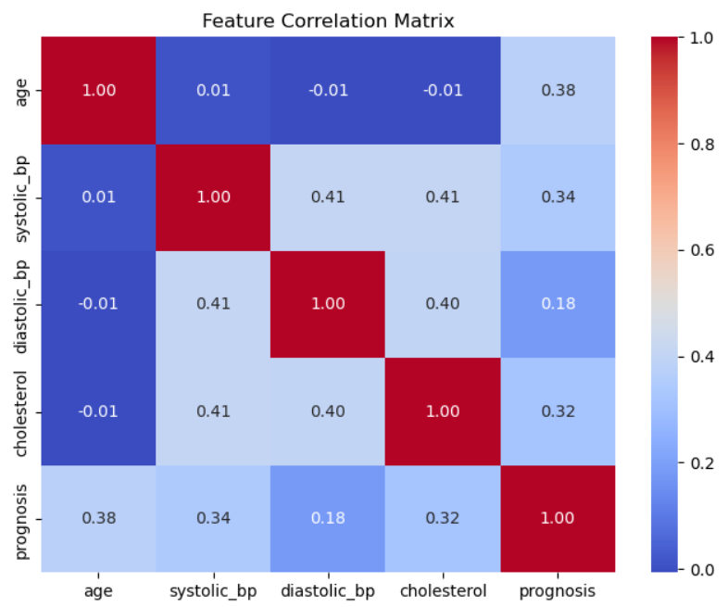
Exploratory Data Analysis (EDA)
Data Cleaning:
Checked for missing values (None found).
Verified duplicate rows (0 duplicates).
Removed unnecessary columns like ID.
Statistical Summary:
Mean Age: ~60 years.
Target Distribution: Balanced dataset with ~3,087 positive cases and ~2,913 negative cases.
Visualizations:
Utilized Matplotlib and Seaborn (likely sns.histplot or sns.boxplot) to check for outliers and the spread of data across different ages and blood pressure levels.
Correlation Heatmap: sns.heatmap to analyze the relationships between numerical features like systolic_bp, diastolic_bp, and cholesterol.
Distribution plots for age and blood pressure.

Slide 6
Feature Engineering
Categorical Encoding: Converted the prognosis text labels ("retinopathy", "no_retinopathy") into numeric format (1 and 0) for model compatibility.
Feature Scaling: Applied StandardScaler to normalize numerical features like systolic_bp and cholesterol, ensuring features with larger ranges don't dominate the model.
Data Splitting: Divided the data into training and testing sets (typically 80/20 or 70/30) to evaluate performance on unseen data.

Slide 7
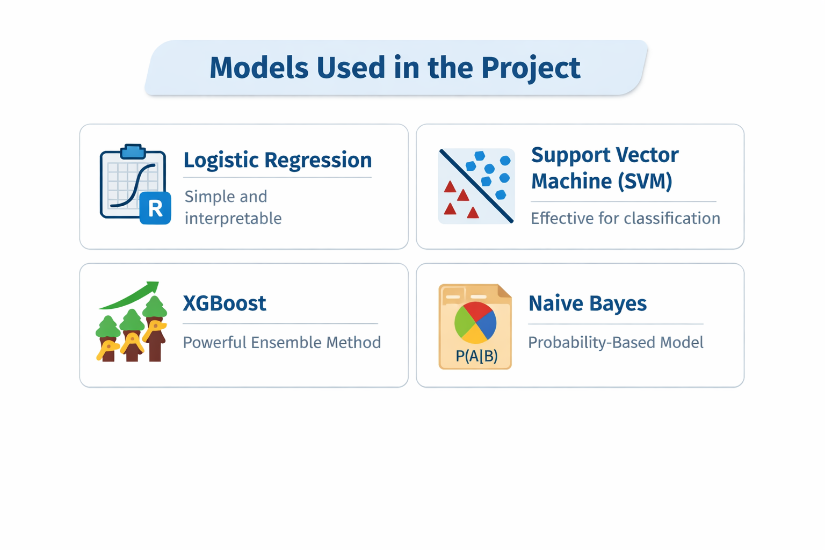
Model Building
Feature Selection and Target Definition: Relevant features are selected and the target variable is defined for prediction.
Data Splitting: The dataset is divided into training and testing sets to evaluate model performance.
Model Selection: Appropriate machine learning algorithms are chosen based on the problem type.
Model Training: The selected models are trained using the training data to learn patterns.

Slide 8
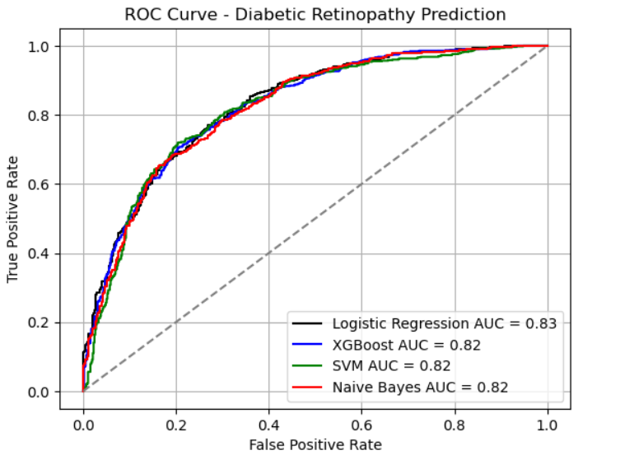
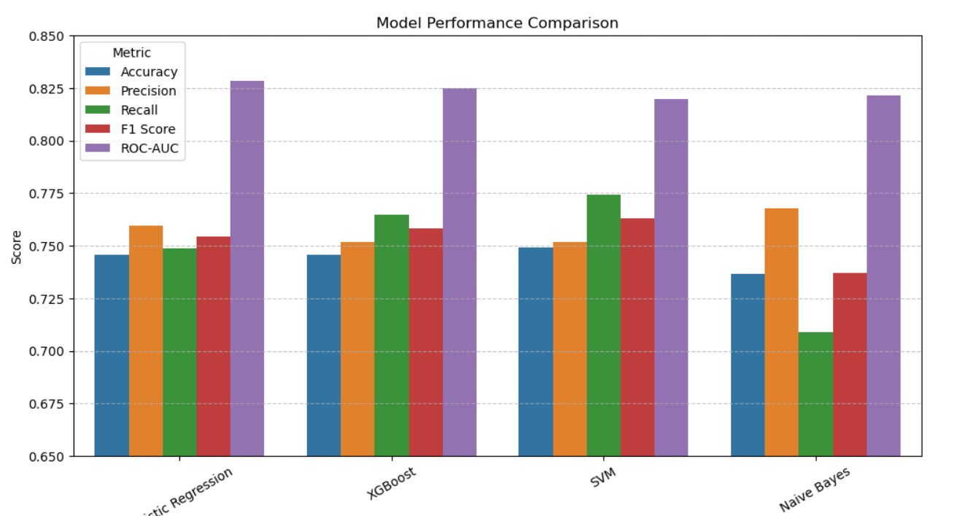
Model Evaluation
Metrics Calculation: Performance is measured using metrics like Precision , Recall and F1 score.
The Winner: Logistic Regression provided the most stable performance across the test set with a high Area Under the Curve (AUC).
The ROC Curve:
Purpose: The ROC Curve visually represents the trade-off between sensitivity (True Positives) and specificity (False Positives).
Interpretation: The closer the curve is to the top-left corner, the better the model is at distinguishing between healthy and diseased patients.
As we got the logistic regression as the best model, we are going to do a deployment prediction (Streamlit App) to generate the predictions based on given inputs

Slide 9
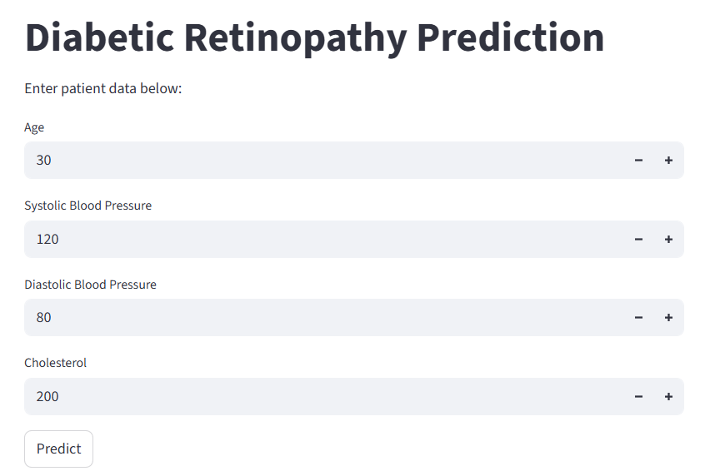
Deployment (StreamlitApp)
Framework: Built a web interface using Streamlit
The trained model is loaded into a Streamlit application for user interaction.
A simple user interface is created to accept input features from users.
The input data is processed and converted into the required format for prediction.
The model generates predictions based on the given inputs.
The prediction results are displayed instantly on the web app.

Slide 10
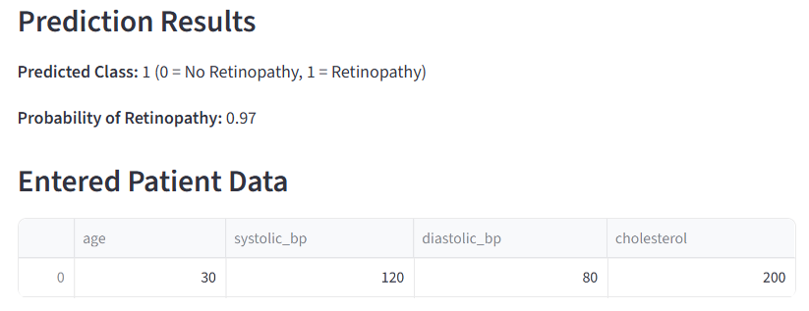
Results & Insights
The model achieved good accuracy and performed well on test data.
Important features were identified as key drivers of predictions.
Data preprocessing and outlier handling improved model performance.
Strong relationships between variables were observed through analysis.
The model provides reliable predictions for decision-making.

Slide 11
Challges Faced
Understanding of medical meaning of variables such as systolic and diastolic , cholesterol.
During visualization of boxplots , we have got outliers so , instead of removing them blindly we analyzed them carefully because extreme values may represent high-risk patients.
We used scatter plots and correlation heatmaps to identify relationships between features like blood pressure and cholesterol.
Multiple visualizations were used to better understand trends and distributions in the data.

Slide 12
Conclusion
The project successfully built a complete machine learning pipeline from data preprocessing to deployment.
Exploratory Data Analysis helped in understanding patterns and improving data quality.
Multiple models were evaluated to select the best-performing one.
The deployed Streamlit app makes the model accessible for real-time use.
The solution enables accurate predictions and supports data-driven decision-making.

Slide 13
THANK YOU

